Slide 1



Slide 2
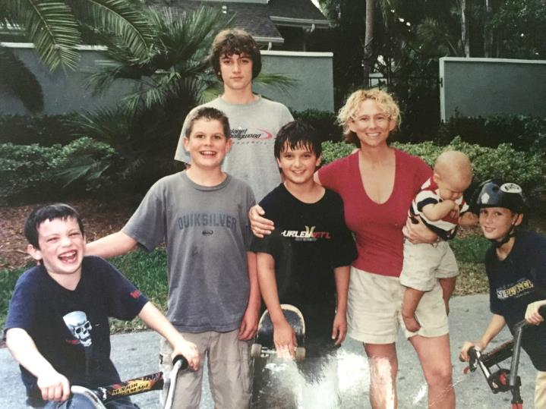
Served on the Tahiti Park Neighborhood Association Board since its inception
^{Currently the President}
Serve on the Executive Board of Coalition of City Neighborhood Association s (CCNA)
^{CCNA Rep from Tahiti Park}
City of Sarasota’s Planning Board for six years from 2009 -2015
^{moved into Tahiti Park 1997}

Slide 3
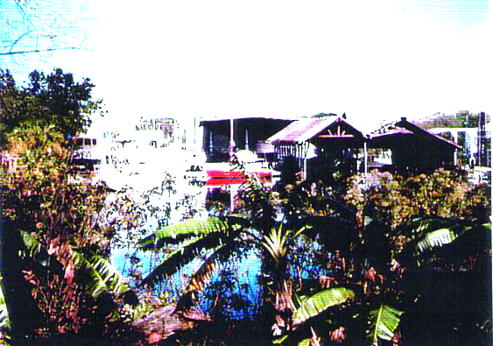
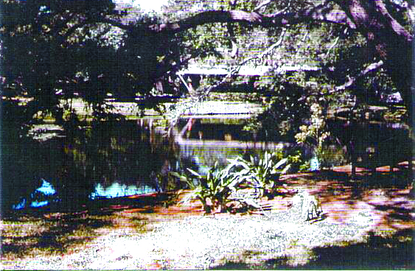
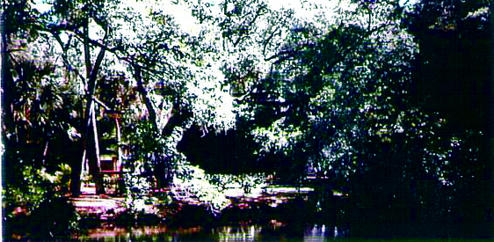
…. until one morning in the summer 2001 my neighbor Pola asked me if I knew anything about the second pond in our n’hood being filled in, during the middle of the night... That was in 2001 and I have been passionately involved with our neighborhood ever since.

Slide 4
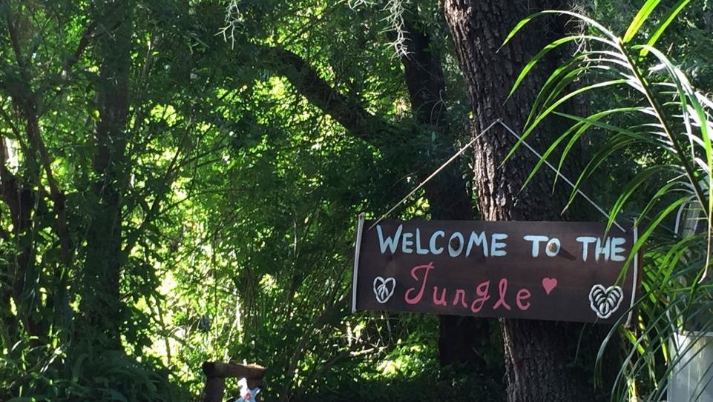

Slide 5
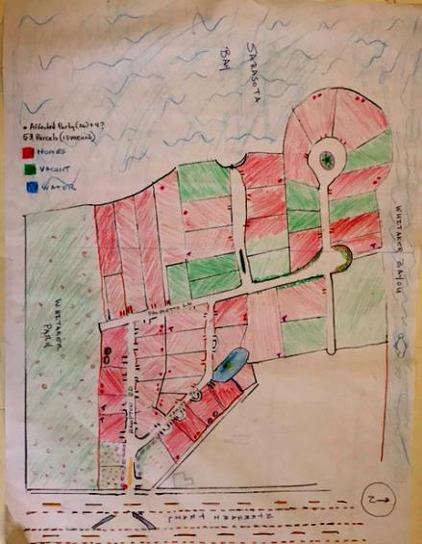
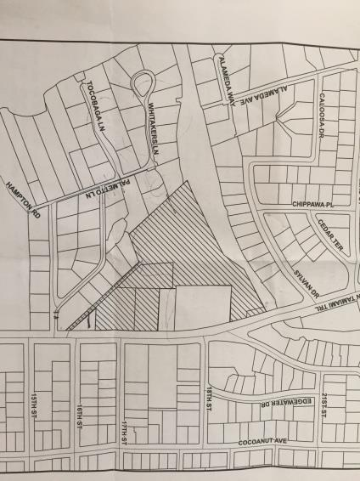
^{Neighborhood Picture:}
Here is a rough map of our Tahiti Park Neighborhood - we are just about one mile directly north of here, and we are bordered on the east by N Tamiami trail, on the south by Whitaker gateway park, on the west by Sarasota Bay, and on the north by Whitaker Bayou.

Slide 6
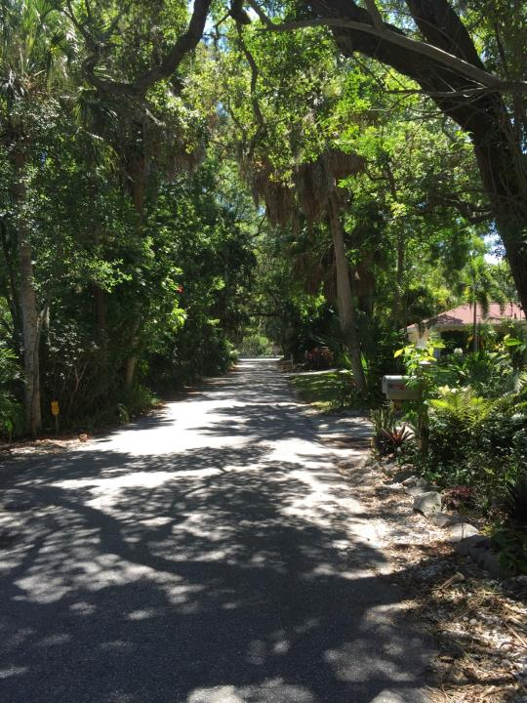
^{Neighborhood Picture:}
There are 53 lots with homes built as early as 1910, and 1950, and we have a couple of houses under construction now. We are very proud of the lush vegetation and old Florida feel.

Slide 7
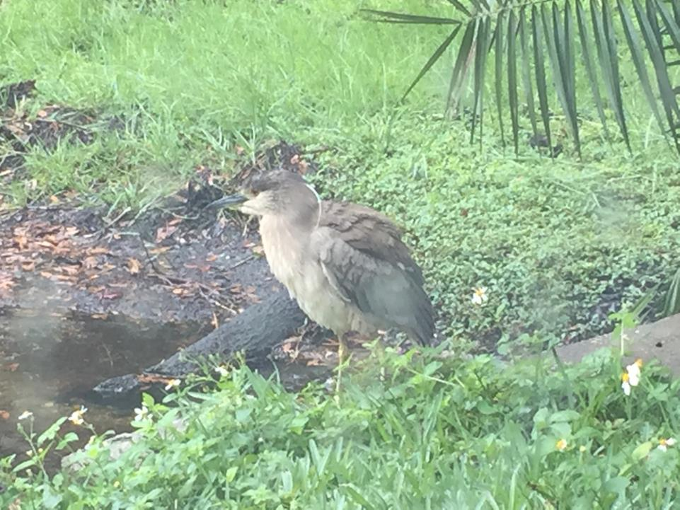

Slide 8
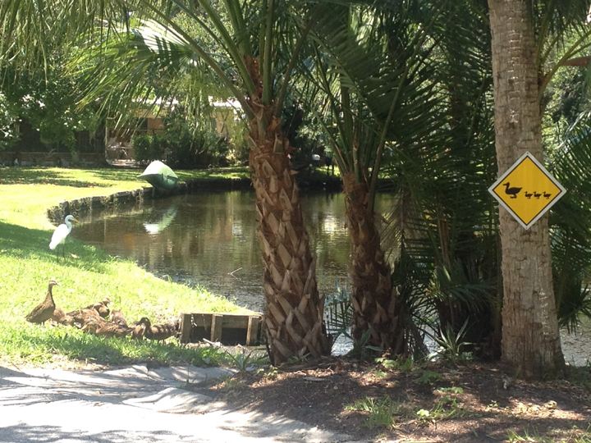

Slide 9
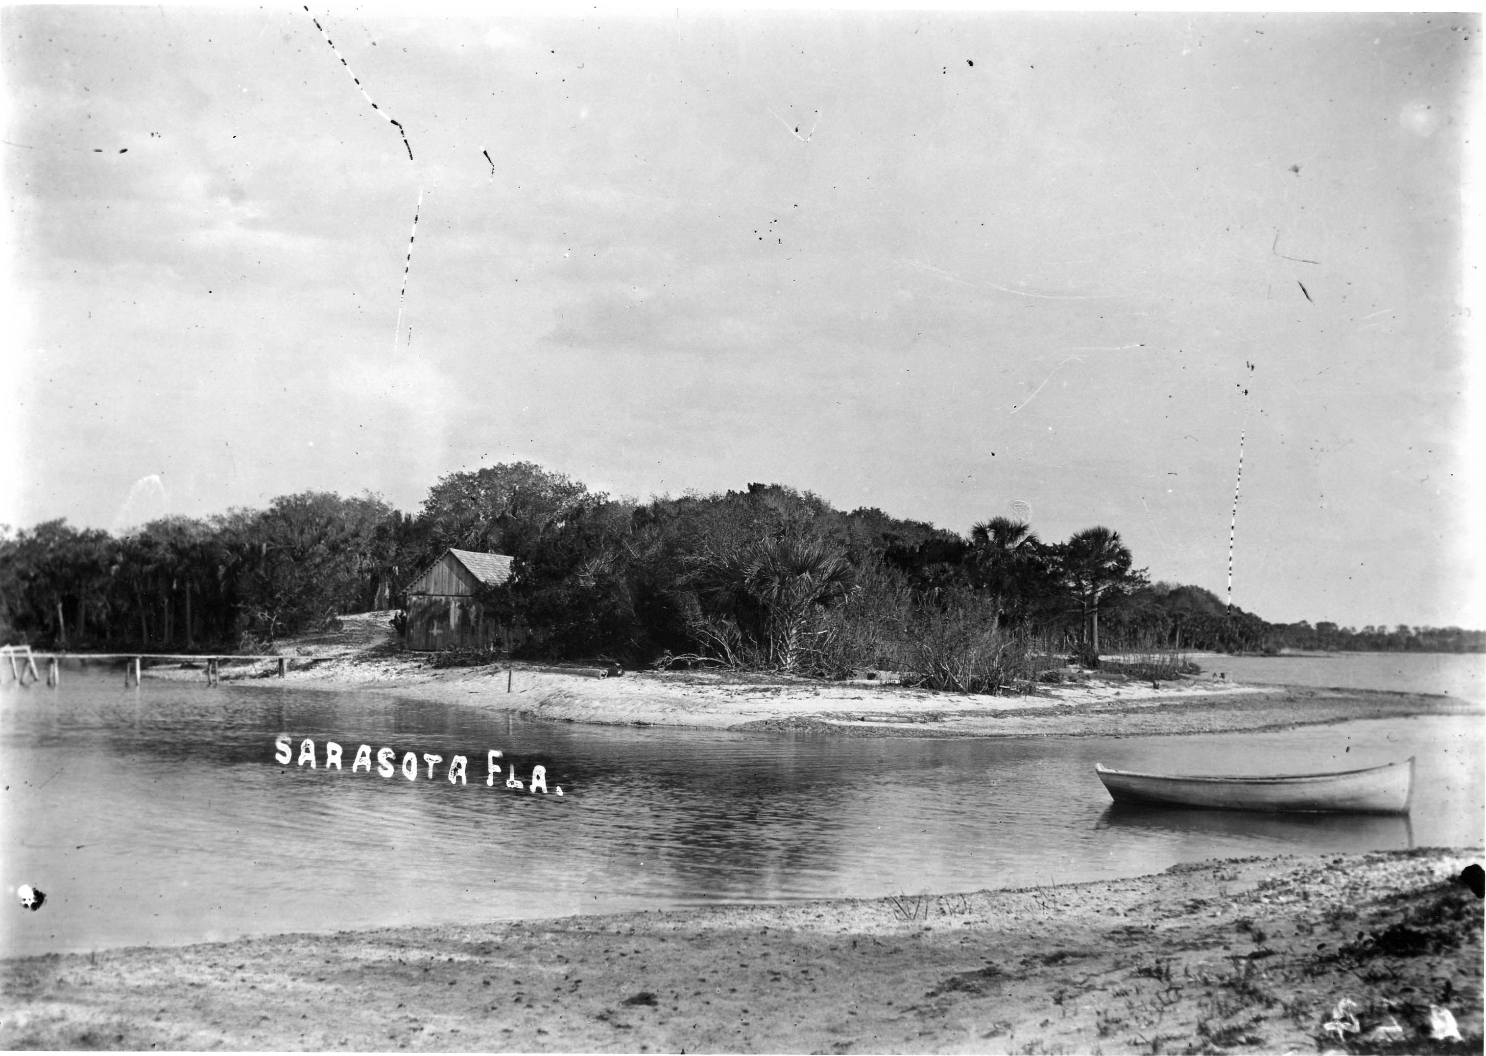
• Sarasota’s first official residents, the Whitakers, after whom the Whitaker Bayou is named, resided in the Tahiti Park area along the Bayou in 1851.
• Some time between 1910-1920 Mr. Lowe (pronounced Lau) built a house on the current YC property where he resided for a year and then created a small boat yard which coexisted, more or less quite peacefully, within the two neighborhoods on either side of the Bayou, (IBSSA and Tahiti Park) with the exception of two rather large fires.

Slide 10
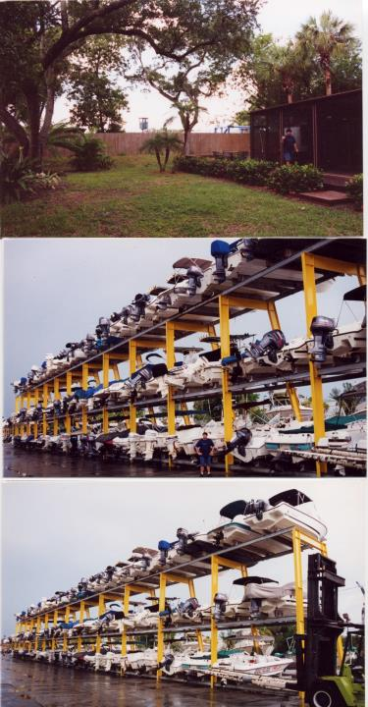
• 2001 Pond is filled in by the developer and property owner in order to make room for his proposed two 40 foot open boat storage racks housing 180 boats.

Slide 11
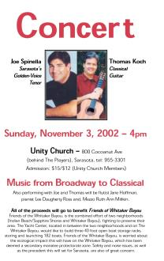
^{• 2001-2002}
• contacted DEP and the YC received a slap on the wrist and fines for the filling in of pond without a permit and for other environmental hazards such as disposing boat cleaning products into the ground and Bayou creating ^{a toxic plume}
• we started neighborhood petition against the boat racks
• Hired an attorney to help us with the Board of Adjustment petition, which challenged Tim Litchet’s (City Planning Official) definition of a Marina - this went to the Board of Adjustment where ^{we lost in a tie vote, 2-2.} A petition was submitted by a BOA member to allow the missing BOA member to view that meeting and vote so it would not be a decision made a by a tie vote ^{but -} again - in a 2-2 vote -we “lost” - so actually we lost twice in a tie vote
• organized a fundraising concert to raise money

Slide 12
^{• August 2003}
• Yacht Center Property is sold and purchased by the Githlers (and others)
• October 8 the YC submitted boat storage project and this went to public hearing before the Planning Board and TP won this hearing 4-1.
The YC pulled this proposal so it did not go forward to public hearing to the CC. And we celebrated.

Slide 13
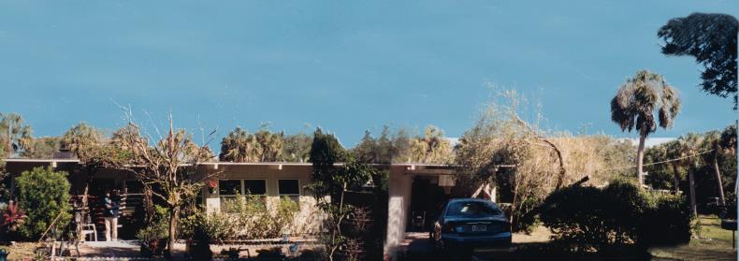
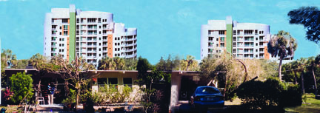
^{• Then in 2004 the} ^{YC} ^{submitted a} new proposal - two 120ft condos with three 65 ft condos /25 units an acre
• January 21 in a Public Hearing before the Planning Board, TPN won 4-1
• March 11 in a Public Hearing before the City Commission, TPN won (4-1)
• March 15, 2004 at a City Commission meeting, a motion was made by a Commissioner to call for a re-vote on The YCs previous request, ^{that was deined}

Slide 14
I wrote on March 2004 concerning the request for a re-vote:
We are open to the developers making a reasonable proposition such as a residential development which blends in with the natural vegetation, environment and canopy of this old established neighborhood.
It is wrong that this neighborhood is being bullied into thinking that a boat storage facility is our only choice.
Do we really need to waste any more of the City’s time and money on the issue of boat racks or do we want to promote residential development along the North Trail?
Let us concentrate on that which we want to accomplish and not on that which has already been denied!
This property is prime real estate and I am confident any imaginative developer can build something neighborhood ^{friendly and profitable.}
From Jennifer Ahearn-Koch to the City Commissioners March 2004

Slide 15
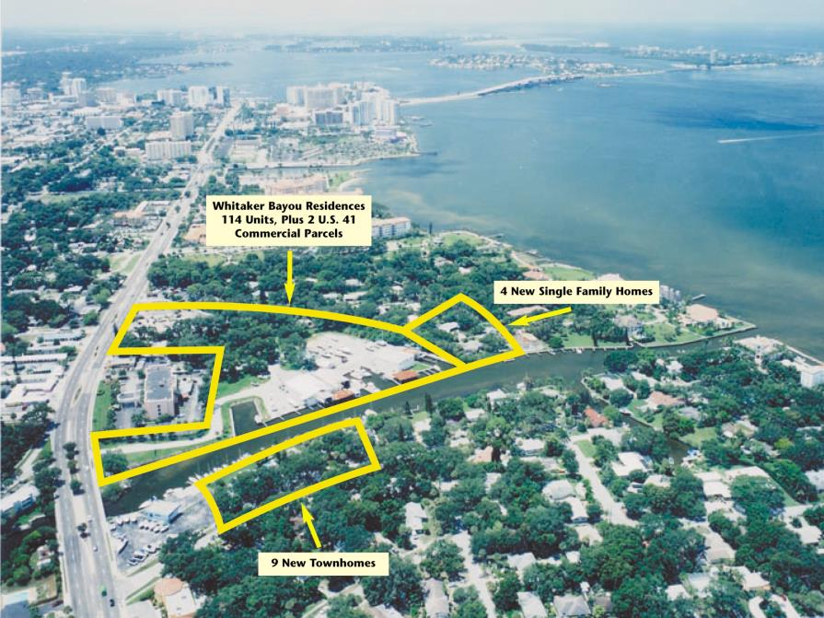
• Feb 5, 2007 the YC submids a new project for review in front of the City Development Review Committee

Slide 16
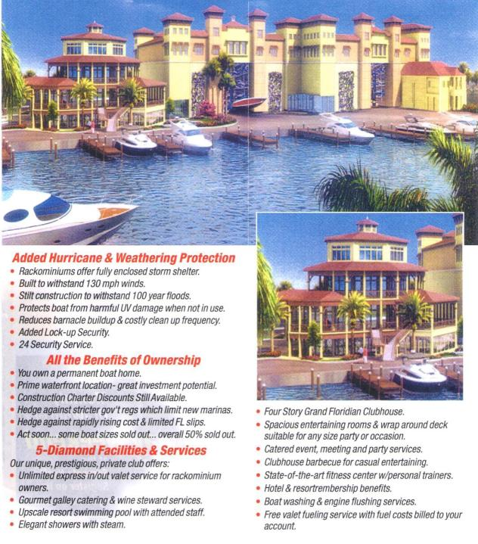
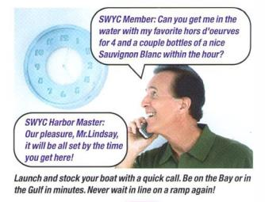
^{• Feb 5, 2007 DRC for the new}
^{Yacht Center Club} ^{Yacht Center Properties:}
^{• Boat Club 4041 square feet}
• Accessory Boat Storage 81,000 sf
^{• Chain Restaurant 5550} ^{sf}
^{• Hotel 78,191 sf}
^{• Gas Station 700 sf}
^{• Total 169,441 square feet}

Slide 17
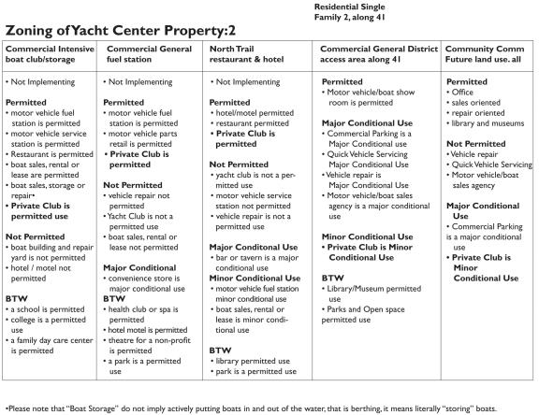
The YC would need two conditional use permits and two site plan approvals from the PB and CC excerpt from a letter from Jennifer Ahearn-Koch to the City Commissioners March 2007-
^{The YC} stated that “they are not getting equal hearing on some issues” and that the City’s planning dept is not working with the developers of the Yacht Center property, that they are making it difficult for them.
Frankly, I think they are making it difficult on themselves. My advice to them is to just look at the current code and what it allows: height, density, usage and set backs, and go from there.
^{Easy!}
• May 14, 2008 Public hearing before the Planning Board TPN loses
• 18 August, 2008 – the Public Hearing before the City Commission ^{is postponed because of storm}
• September 3, 2008 – a Public Hearing before the City Commission is held but it is just Part 1 and continued to the next meeting because it took the entire evening
• September 22, 2008 – a continuation of the public hearing is held before the City Commission, Part 2, and went from 6pm to 11:22pm, TP lost a very painful 2-3
• While that was not really the end, it is as far as I am going on the time line for now.
^{Jennifer Ahearn-Koch}
City Commission Meeting Sep 2008
I stand to gain nothing personally by being here tonight. Tonight is just a couple of hours amongst the hundreds of hours I have spent over the last seven years. I do this because it is my civic duty to speak out and to try to protect my neighborhood and my city, not because I want to deny anyone something. While it is my civic duty to try to protect this city, may I respectfully, remind you that it is your job to protect it as well, and that includes the neighborhoods. I am concerned about the future of Sarasota and I am asking you vote NO to the Whitaker Yacht Club’s marina. In doing so, you will be encouraging real progress, maintaining growth and protecting the uniqueness and value of our City, a Sarasota for everyone.

Slide 18
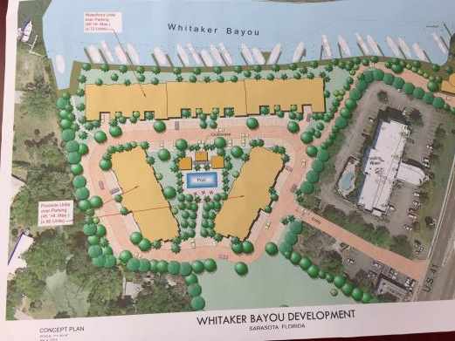
Neighborhood activists are often labeled as being against “progress”, which is silly, there is no way to stop “progress”.
But, “progress” and development are not the same thing, especially in this context.
Progress is betterment and improvement. Development, as applied to our situation, is construction at the cost of neighborhoods. In too many cases, development is haphazard growth, not betterment or improvement.
A city can both progress and develop well, but a city that does so, is balanced and prepared. Progress can occur without destroying neighborhoods.
Developers can and should work hand in hand with neighborhoods, city leaders and planners.
Personally, I look forward to the day when this can happen in my own neighborhood ...
^{now that would be progress!}
From Jennifer Ahearn-Koch to the City Commissioners March 2006

Slide 19

^{Take Away}
• Don’t be afraid or intimidated to get involved and ask questions
• If someone tells you something you don’t understand, ask to explain
• read the zoning code, comp plan, ordinance references for yourself, in full, and again, if you don't understand some acronym or definition, look it up, question everything
• look to outside sources for help, other neighbors who have gone through similar situations, non-profit organizations, etc
• Remember that the City / County staff work for you, their job is to work with the citizens and the developers to facilitate and inform
• make all of your objections and findings in writing and ask them to be part of the record
• document everything, even conversations

